Slide 1
Software Testing
Topic 8
Part 1

Slide 2
Introduction to Software Testing
• Terminology
• Testing Types
– Unit
– Integration
– System
• Continuous Integration
• Test-Driven Devlopment

Slide 3
What is the purpose of testing?
• Historical View
– Testing is done to show the system works
– Tend to go easy on the program
– Programmers use same logic to test as they did to code
– Some (many) bugs do not get caught
• Modern View
– Testing is done to uncover bugs
– We purposely take the attitude of trying to break the program
– Result: more bugs caught, more reliable system

Slide 4
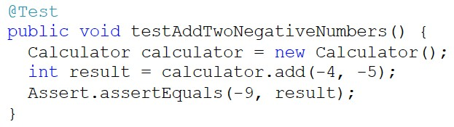
Terminology
• Test case
– A set or sequence of inputs used to test a program, along with an expected output
– JUnit Ex:

Slide 5
Terminology
• Test suite
– A set of test cases

Slide 6
Testing builds confidence in code
• Good test cases
– one we think is likely to uncover a bug
• Good test suite
– contains enough good test cases to test the requirements thoroughly
– Having software that consistently passes a good test suite is more likely to be reliable upon release

Slide 7
Terminology
• Bug
– Informal term that can mean several different things
– Sometimes, it is more useful to use precise terminology
• Failure
– Something the program does wrong (crashing, incorrect result)
• Fault
– The incorrect code causing the failure (= instead of ==)
• Error
– Mistake the programmer made leading to the fault
• e.g. made a typo or didn’t realize that == was needed

Slide 8
Can we catch them all?
• Software errors tend to follow the Pareto Principle (80-20 rule)
– 80% of the failures caused by 20% of the faults
• Easier to find – failures occur frequently
– 20% of the failures caused by 80% of the faults
• Less frequent and therefore harder to find

Slide 9
Can we catch them all?
• Some failures may be very hard to find
– Timing issues (race conditions)
– Complex interactions with external systems
• In a large system, it is likely we will never find all the bugs
– Avoid, find, eliminate as many bugs as possible
– Build failsafe checks to alleviate effects of faults

Slide 10
Can we catch them all?
• Create systems to have failures reported
– Error reports
• automatically submitted upon failure
– Bug reports
• submitted by developers and/or users
– Beta-testing
• Release “beta” version for users to try

Slide 11
Testing vs. Debugging
Testing: running test cases, finding failures
– Can often be done without looking at the code
– Can be automated or partially automated
Debugging: finding and correcting faults
– Need to work with the code
– Use a debugger
– Cannot generally be automated
– Static analysis tools exist for finding certain faults (ex. findbugs)

Slide 12
Automated Testing
• Whenever possible!
• Automating tests:
– Use a “driver”
• simple program existing solely to test a function or module
– Testing with a driver
• Write the driver
• Compile the driver together with the module
• Run the driver
– In practice, this should be used only for the simplest of programs. In reality, we use a test framework like JUnit, which acts as the driver of our tests.

Slide 13
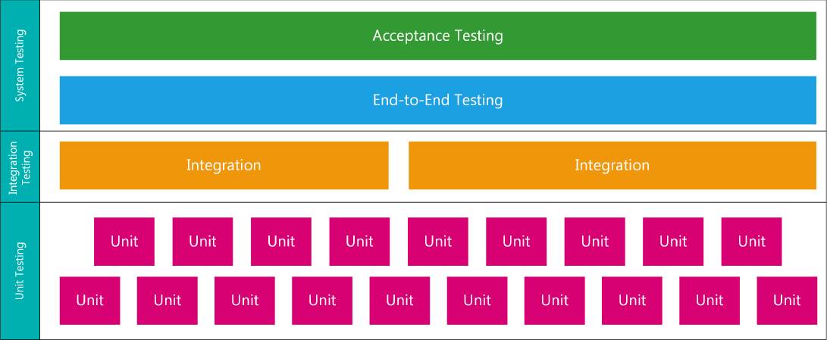
Types of Testing

Slide 14
Unit Testing
• Test individual methods and classes
• Test components in isolation from each other

Slide 15


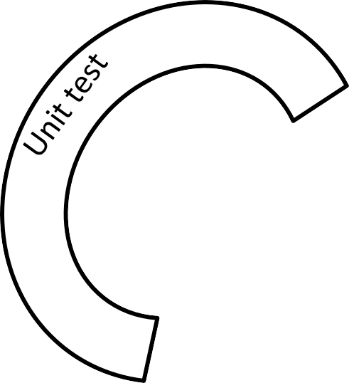



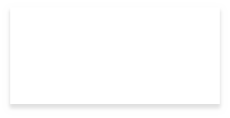

Unit Testing
• Test each class independently
– Or each software component
ClassOne
ClassTwo

Slide 16


Integration Testing
• Ensure that modules compile and interoperate correctly
Integration test
ClassOne
ClassTwo

Slide 17
Wait…
• How do we unit test ClassTwo if it requires ClassOne?
• We need some kind stand-in
• Some options:
– Stub methods
– Fake classes/objects
– Mock objects

Slide 18
Stub
• Stand in for a function not yet written/integrated
• Simple, usually returning known value
• “stubbed out” methods are invoked to run testing

Slide 19
Stubs
We’ll usually use a stub method if a method we need to test
• Uses other methods/classes that aren’t finished yet
– Stub out the unfinished methods/classes
• Uses methods/classes that work with external sources
– (files, database, network)
– Unit tests need to be fast (don’t want to wait for i/o when not necessary)
– Unit tests need to be isolated (code + database = integration test)
– Stub out these methods/classes
• Uses methods that return different values based on date/ time
• Uses stochastic (non-deterministic) methods

Slide 20

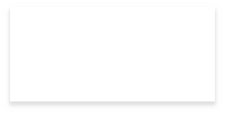




Stubbing Methods
• Can be done manually
– Ex. Can create a subclass of ClassOne with some methods implemented/overridden as stubs, and use this for tests
ClassOne
ClassOneWithStubs
ClassTwo

Slide 21
Stubbing Stochastic Methods
• Stubs are easy to create for deterministic methods.
• What about non-deterministic methods that exhibit unpredictable behaviour?
– Always return the same value
– Always return the same sequence of values
• Use a static variable to track how many times the method has been called
• On the first invocation, we’ll return 5
• On the second invocation, we’ll return 99
• …

Slide 22
Fake Objects
• Several definitions exist
– Object that has all methods implemented as stubs
– Object that takes some kind of shortcut making it unsuitable for the final product

Slide 23
Unit vs. Integration Tests
• With only integration tests, can’t definitively say
– The problem is in your code
– The problem is in the database
We waste time finding the bug
• Unit + integration tests means
– My code works
– My code works with the database
– My code works with your code

Slide 24
Mocks
• Can often be confused with stubs
– Mocks do allow us to stub methods
– Also allow us to:
• Verify that specific methods were called
• Verify that specific arguments were passed
• Thus, we can record and verify the interactions between the class and its collaborators

Slide 25
Continuous Integration
(Common) Scenario
• Joe and Jane are working on a project
– They each implement a few classes
– Code them
– Ensure they are well tested
• When they’re each done, they integrate them
– Everything breaks

Slide 26
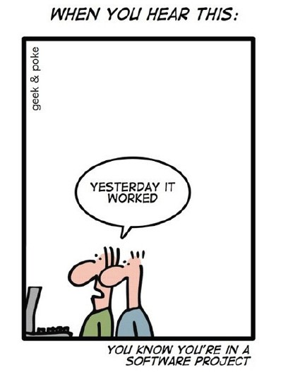
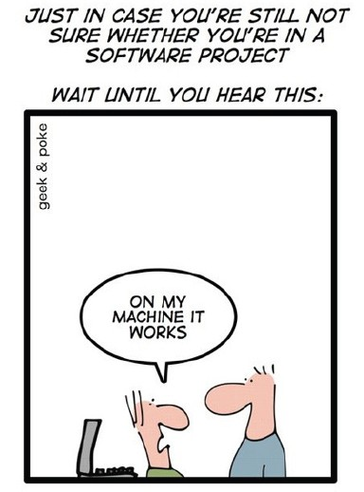
Integration Pain
That awkward moment near the end of a project when everyone realizes that none of their classes interoperate correctly

Slide 27
Integration Pain
• Extremely risky for a project
• Difficult to determine time required to resolve the integration problems
– May (vastly) exceed our budget/expertise
– May (vastly) exceed our schedule

Slide 28
Continuous Integration
– Mitigates risks associated with integrating software
– Avoids integration pains
– Integrate early and integrate often
• i.e. on every change

Slide 29
Types of Testing

Slide 30
System Testing
• Testing the entire system
– End-to-end
• Tests workflows or paths
– happy paths and unhappy paths
– Acceptance
• Tests done by the client in “accepting” that the requirements of the contract are met (so they pay you)
– …or by tester acting as such
• Suite of tests defining when a requirement or user story is “done”

Slide 31
Automating Acceptance Tests
Benefit of MVC-like system designs
Substitute a test driver class for the GUI view.
Interact with the controller and model as the GUI would
In a REST-based application, testing back and front ends can initially be done in isolation

